Slide 1

ONLINE MOVIE TICKETS BOOKING SYSTEM
NMS CINEMA

Slide 2
RLL project PRESENTATION on ---------------------------------ONLINE MOVIE TICKET BOOKING SYSTEM --------------------------------- Presented By : Group:- 4
NAME
SOUMYA RANJAN ROUT
TANUJ PANDEY
DHINESHKUMAR A
VEDANT SAHANE
UJJWAL AKASH
KARAMSETTY MANEESH
RAKSHITH SHETTY
AMAN SRIVASTAV

Slide 3

INTRODUCTION
The traditional way of getting movie tickets requires customers to visit the theater in person, wait in line, and buy tickets. This method poses challenges in terms of convenience and time efficiency.
Our project aims to improve this by offering insights into online movie ticket booking systems. We'll highlight the tasks performed by various stakeholders in the supply chain and provide an automated platform for internet-based ticket reservations.
Our project's core lies in capturing the activities of different participants in the ticketing process. We'll use advanced techniques to ensure up-to-date information management, enhancing operational efficiency. By comprehensively explaining online ticketing intricacies and roles within the supply chain, our project offers a holistic solution to traditional ticketing challenges.

Slide 4
Background of the Project:
NMS Cinemas is a group of movie theaters that show different kinds of movies at affordable prices. They started in 2004 in Pune, India. Lately, the people who study the business noticed that their sales went down after 2010. They figured out that apps like BookMyShow and Paytm were making more money by letting people book tickets online, without needing middlemen. Because of this, the team decided to hire someone who can build a website for booking movie tickets. They want the website to be easy for users and look nice. They hired you as a developer to make this website. The bosses gave you the things the website needs and how their business works, so you can make different parts of the website fit together.

Slide 5

Tools and Technologies:
Front End: Angular/HTML/CSS
Server-Side: Spring Boot
Backend: MySQL , Hibernate
Server: Tomcat
Operating System: Windows 11
Developing Method: Agile Methodology

Slide 6
User Role:
Register
Register to the application
Sign In
Sign into the application to maintain the record of activities
Apply
Apply filters and sort results based on different genres
Experience
Experience a seamless payment process.
Receive
Receive a booking summary page once the payment is complete.
Search
Search for movie shows based on the shows currently airing

Slide 7
Admin Role:
Login to portal
Add or remove different genres to or from the application to build a rich product line.
Edit movie details like name,banner,language, description to keep it aligned to the current prices.
Enable or disable movie shows.
Delete the movies.
View different genres.
Add Theatre and Edit Accordingly
Booking history of the User can be seen

Slide 8
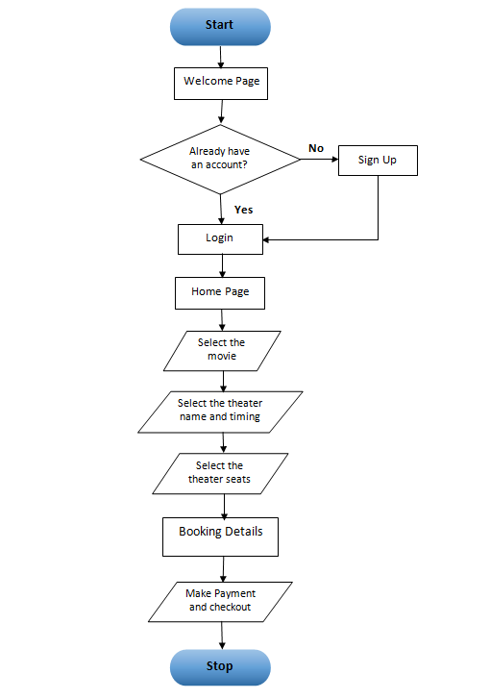
Flow Chart:

Slide 9
ER-Diagram For Admin Part
username
Show_id
id
theatre_id
Can
see
Admin
booking_history
checkout_id
password
user_id
movie_id

Slide 10
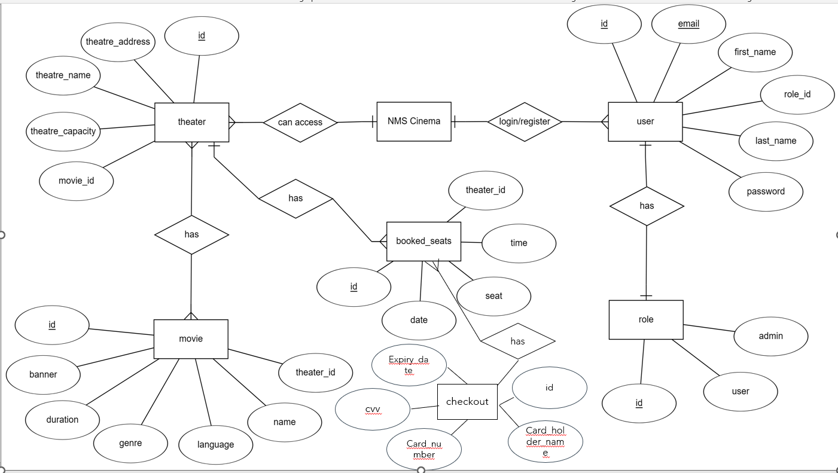
ER-Diagram For User Part

Slide 11

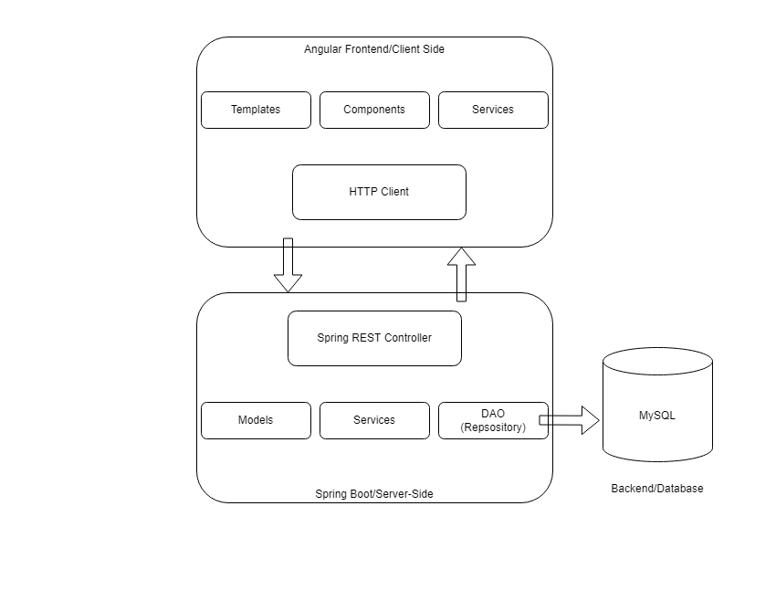
Model Used:

Slide 12
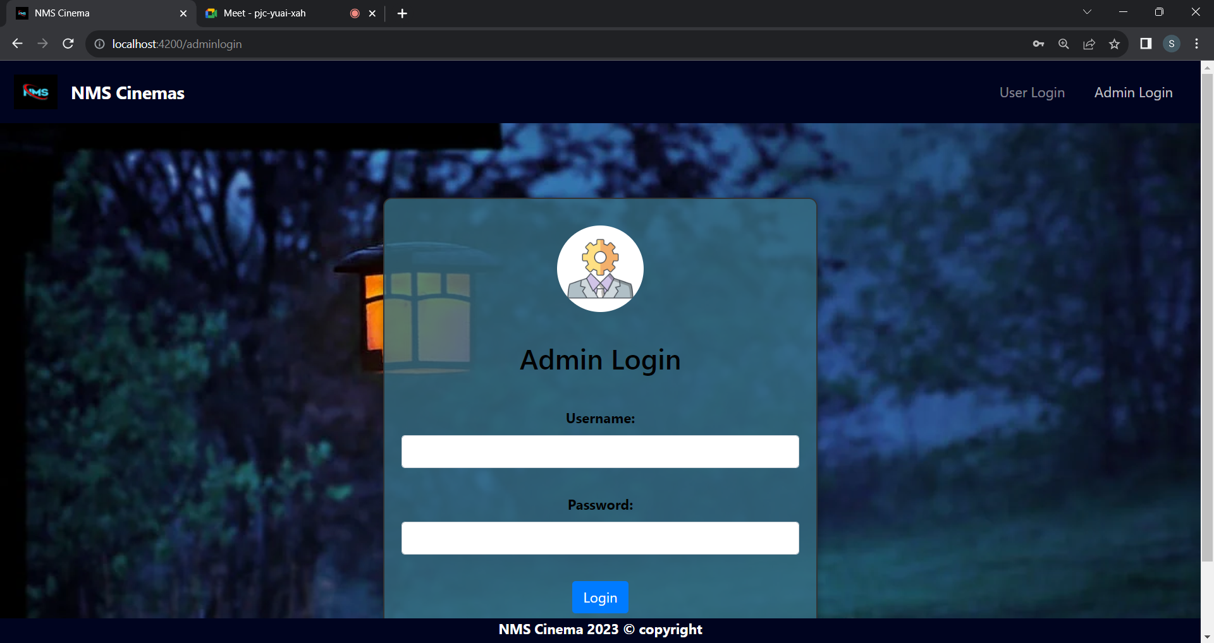
Login Page:
ADMIN LOGIN

Slide 13
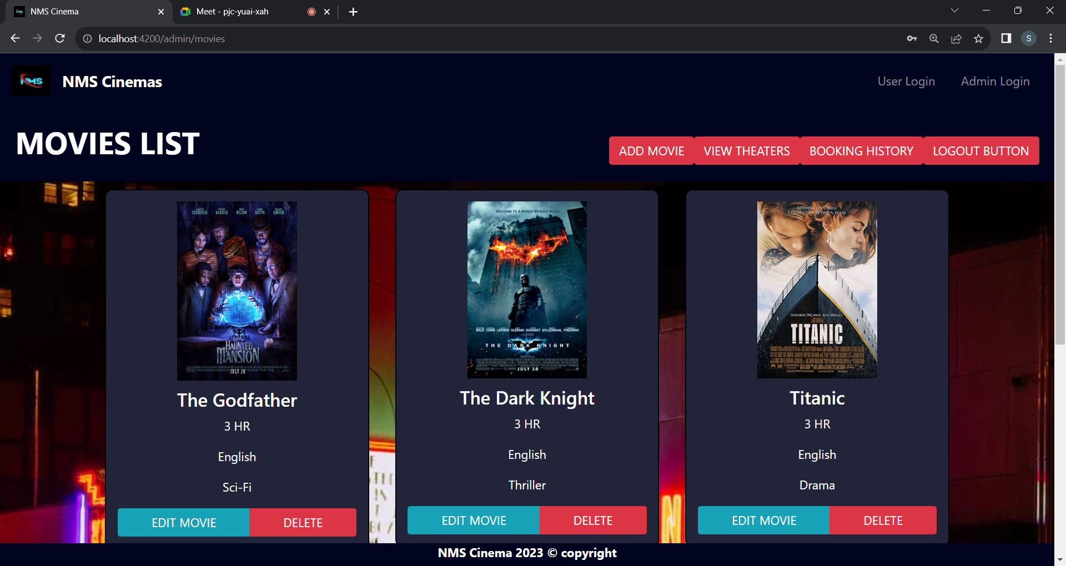
ADMIN MOVIES

Slide 14
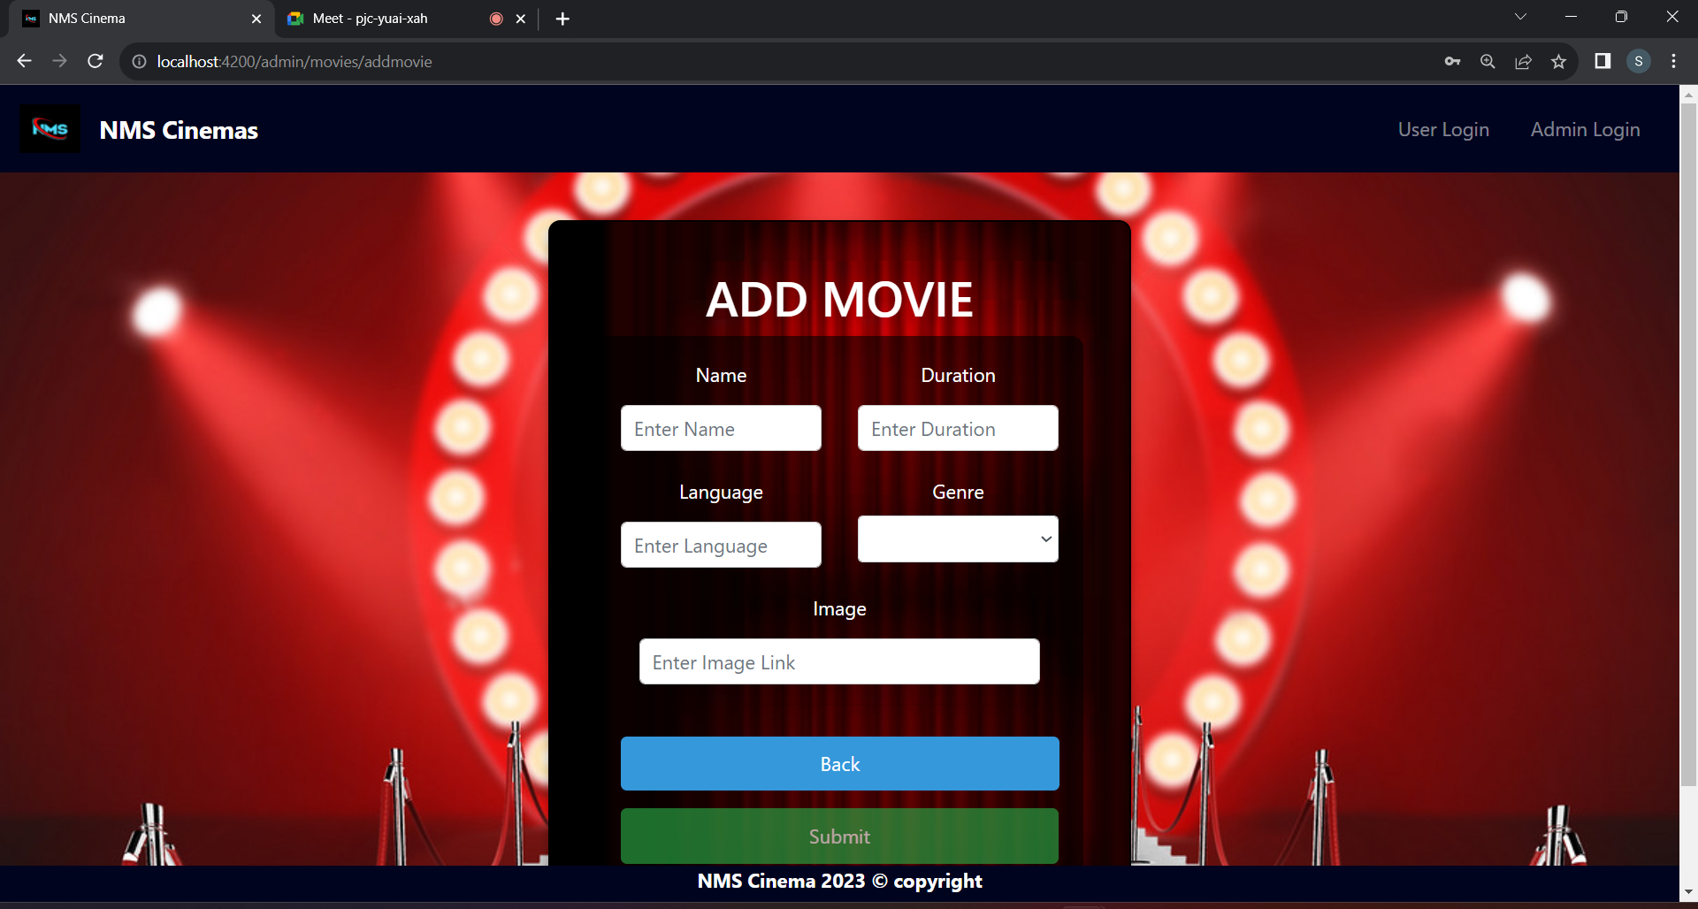
ADMIN ADD MOVIE

Slide 15
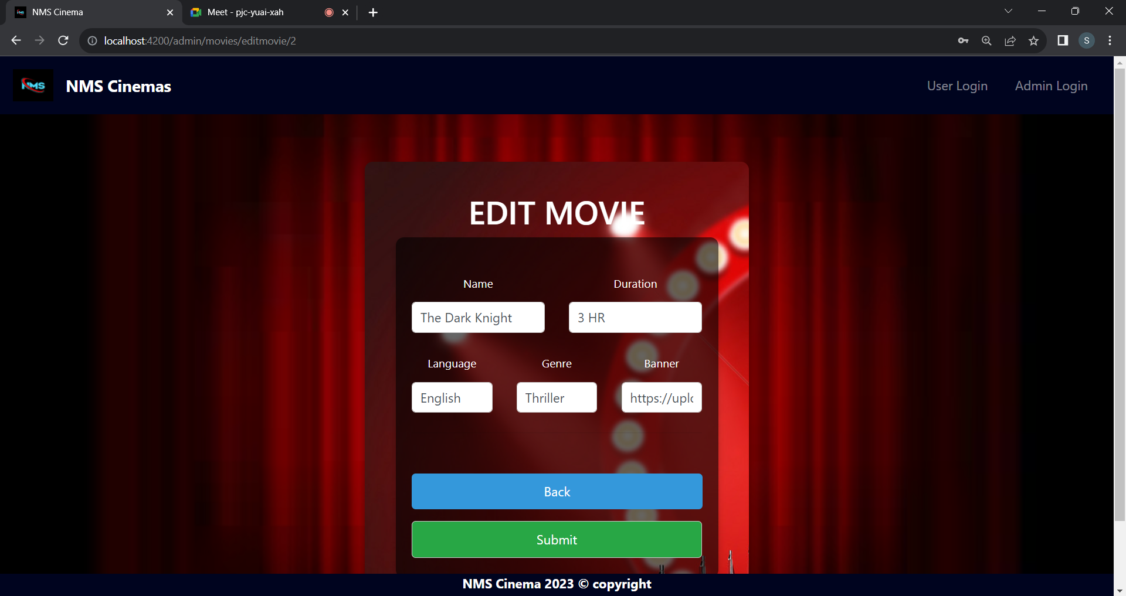
ADMIN EDIT MOVIE

Slide 16
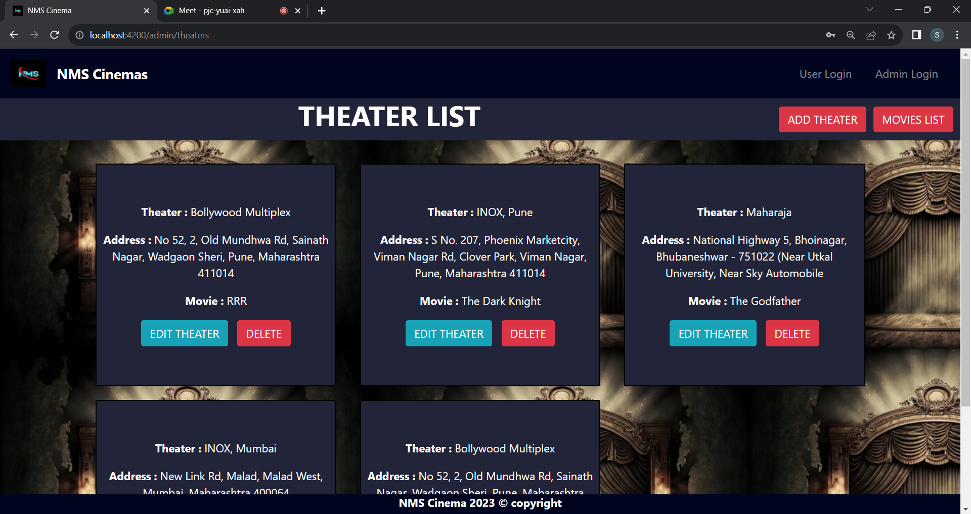
ADMIN THEATER

Slide 17
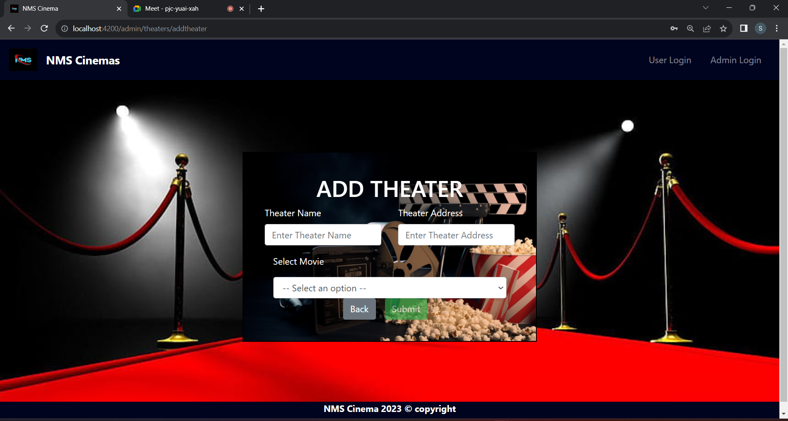
ADMIN ADD THEATER

Slide 18
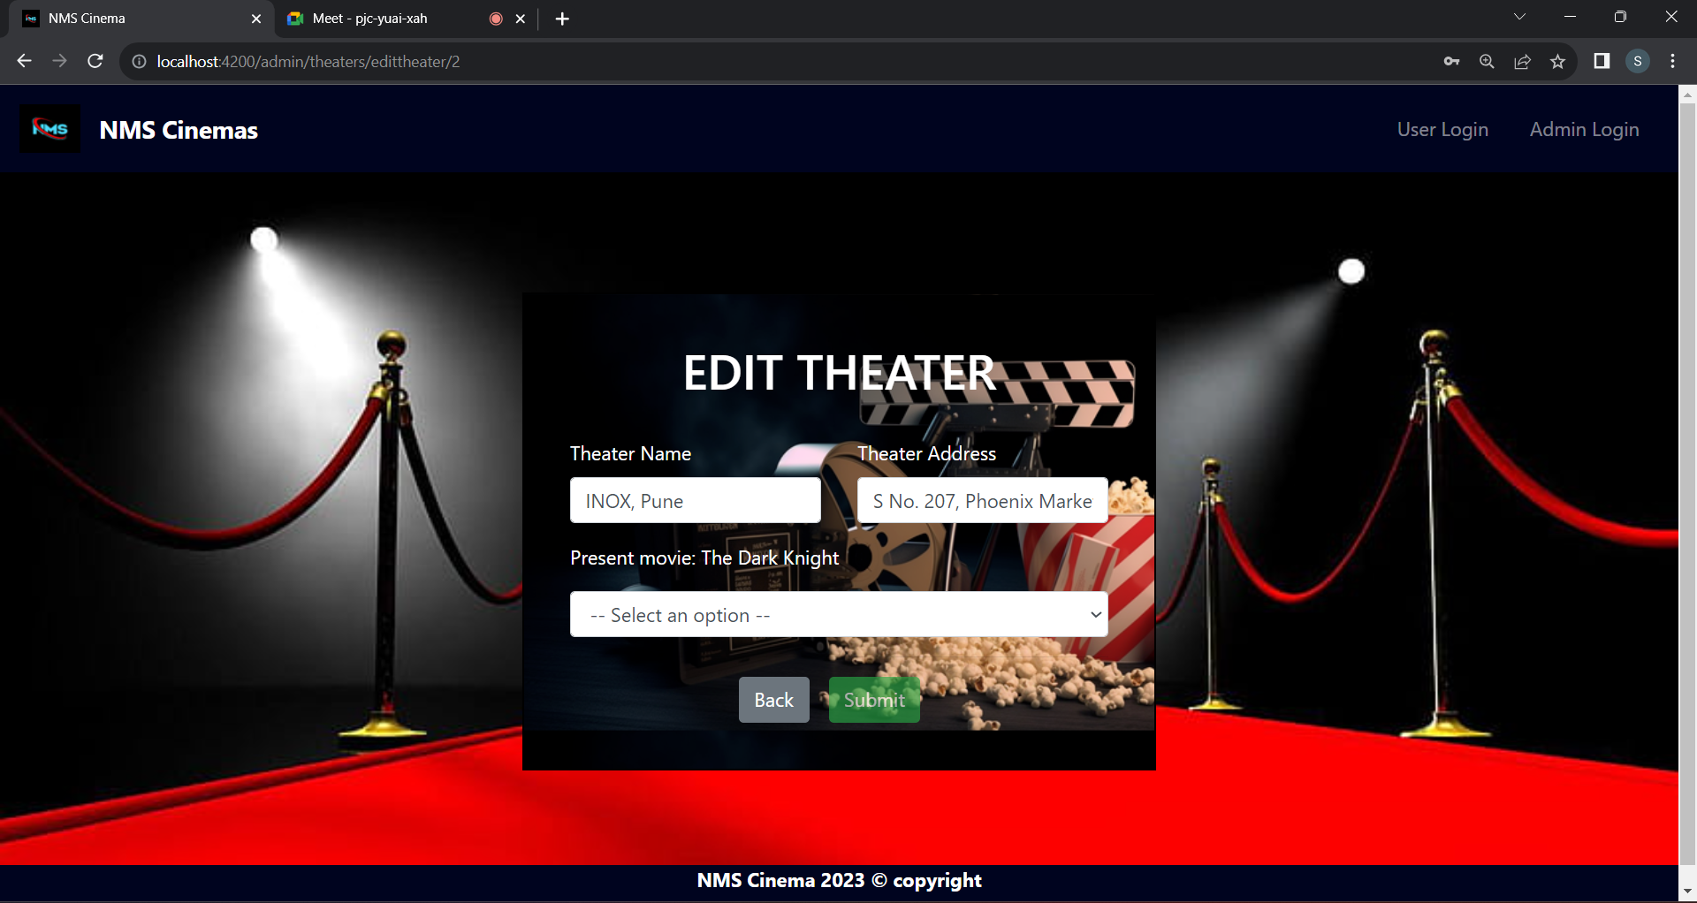
ADMIN EDIT THEATER

Slide 19
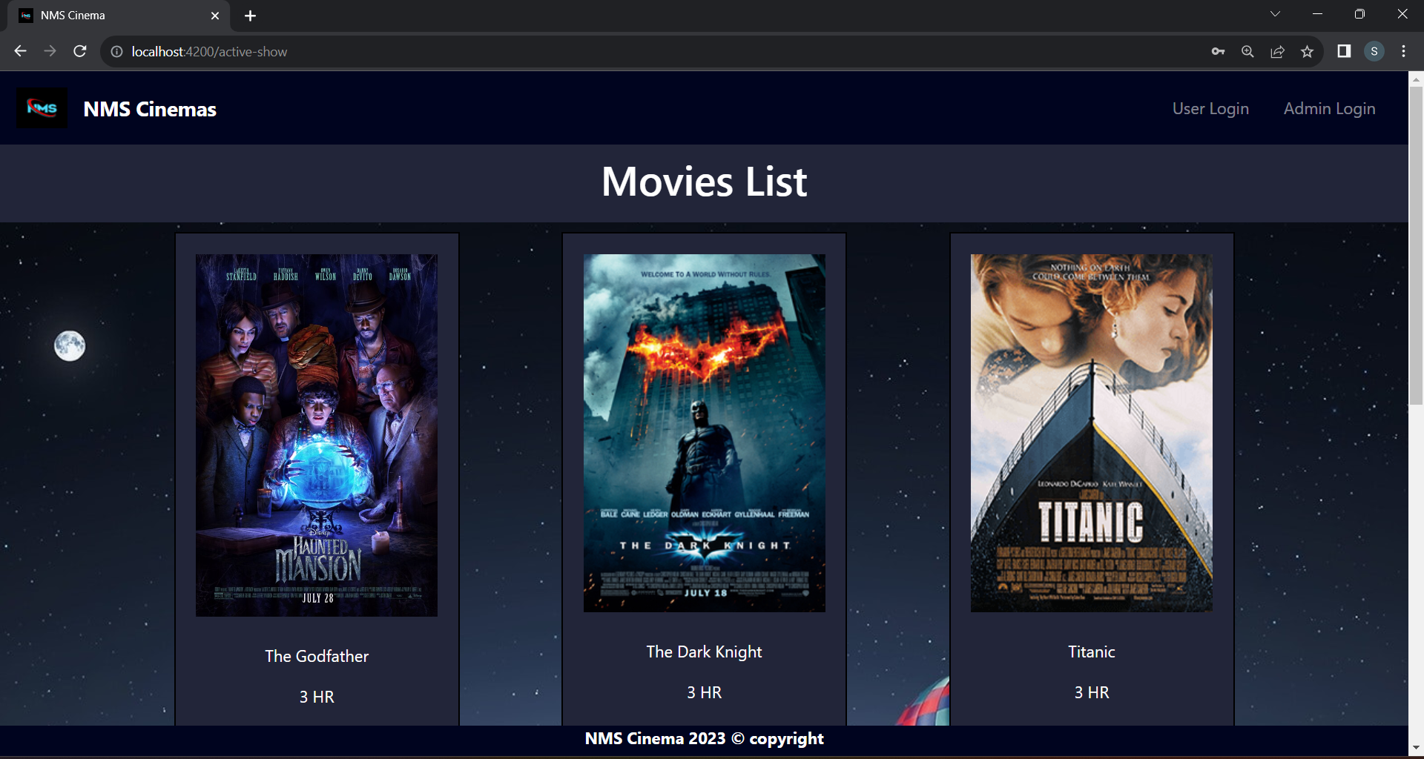
MOVIE SHOW

Slide 20
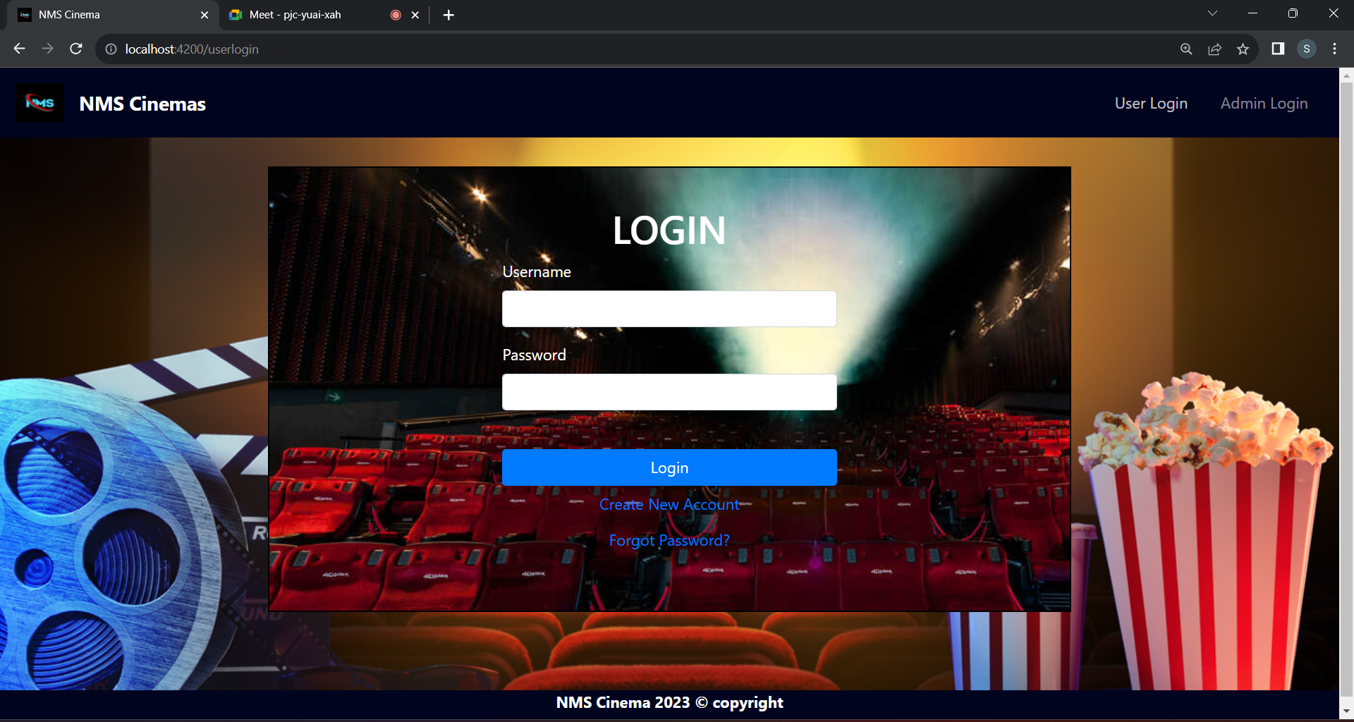
USER LOGIN

Slide 21
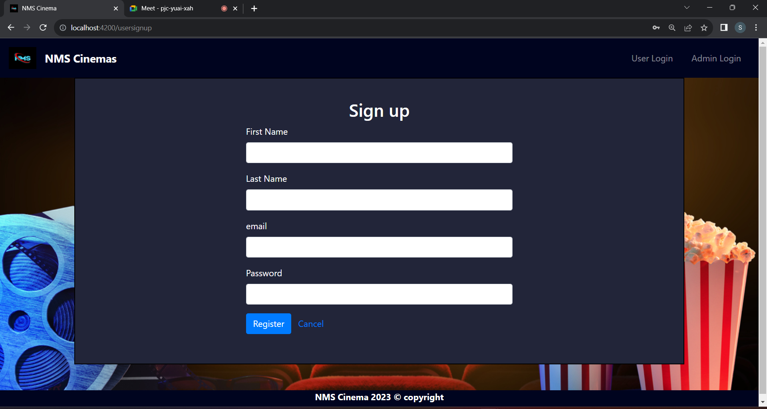
USER SIGNUP

Slide 22
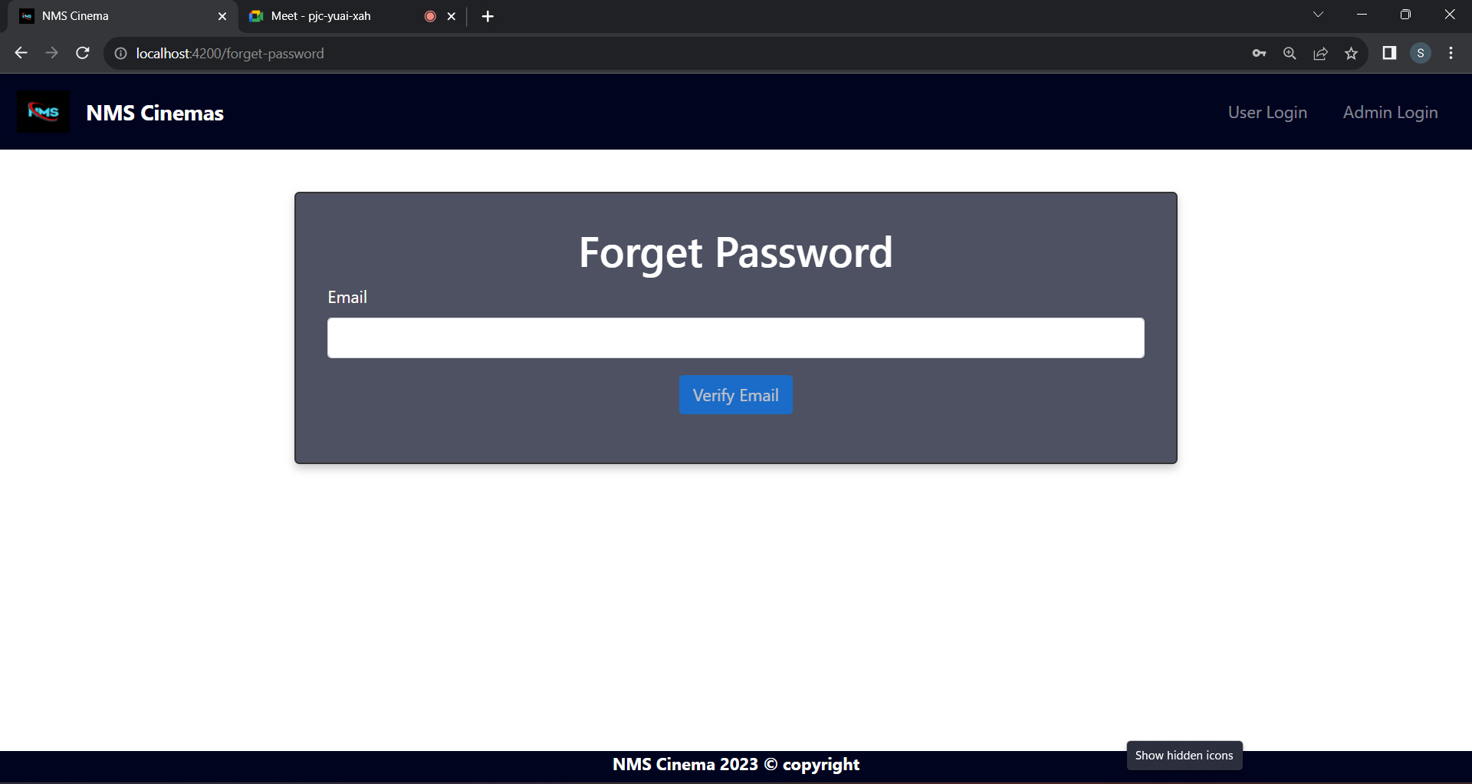
FORGET-PASSWORD

Slide 23
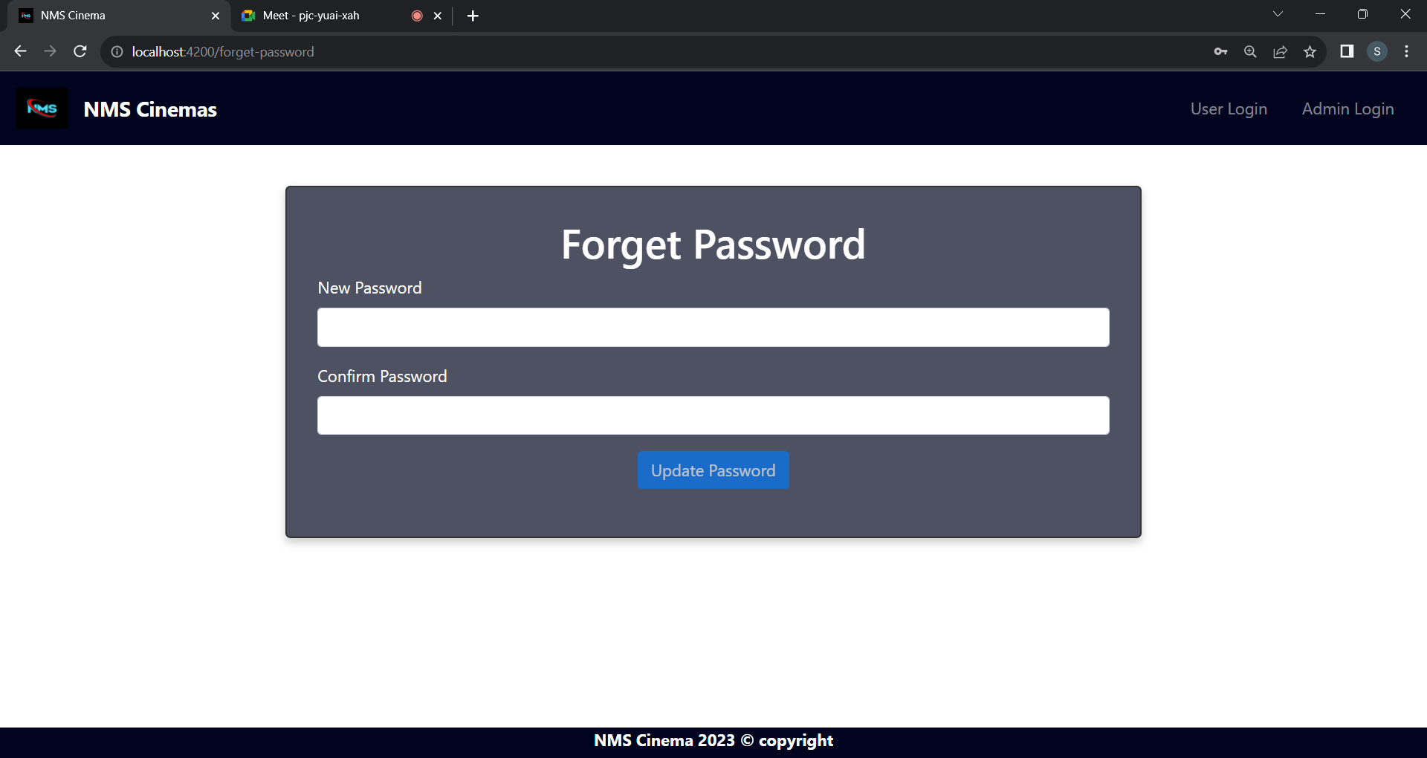
FORGET-PASSWORD

Slide 24
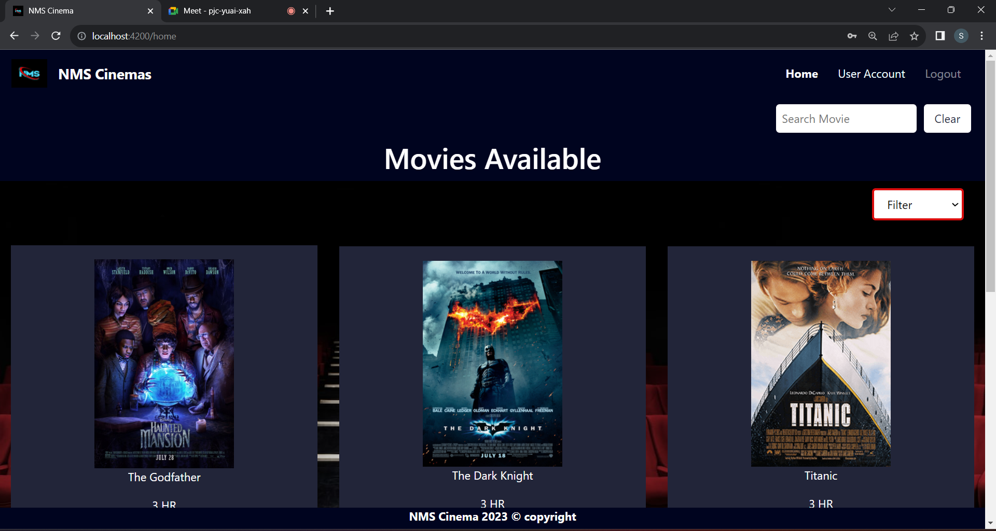
USER-HOME

Slide 25
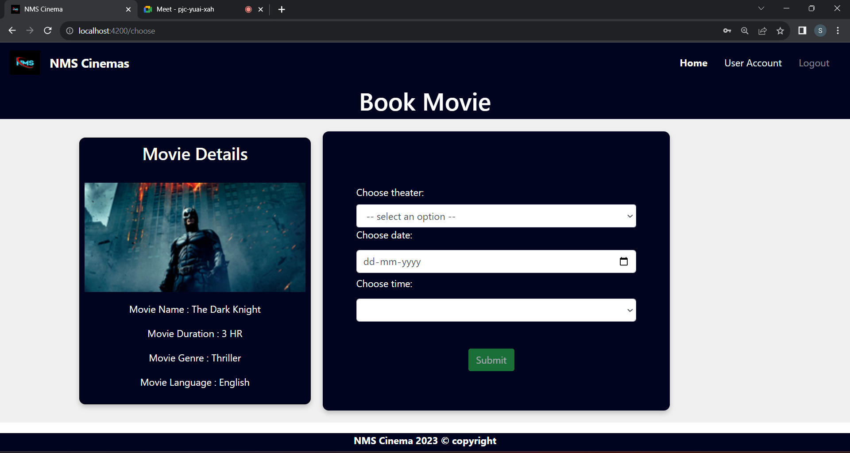
CHOOSE-MOVIE

Slide 26
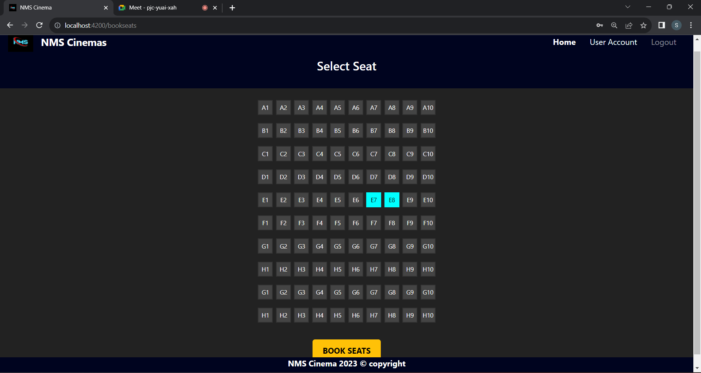
BOOK-SEAT

Slide 27
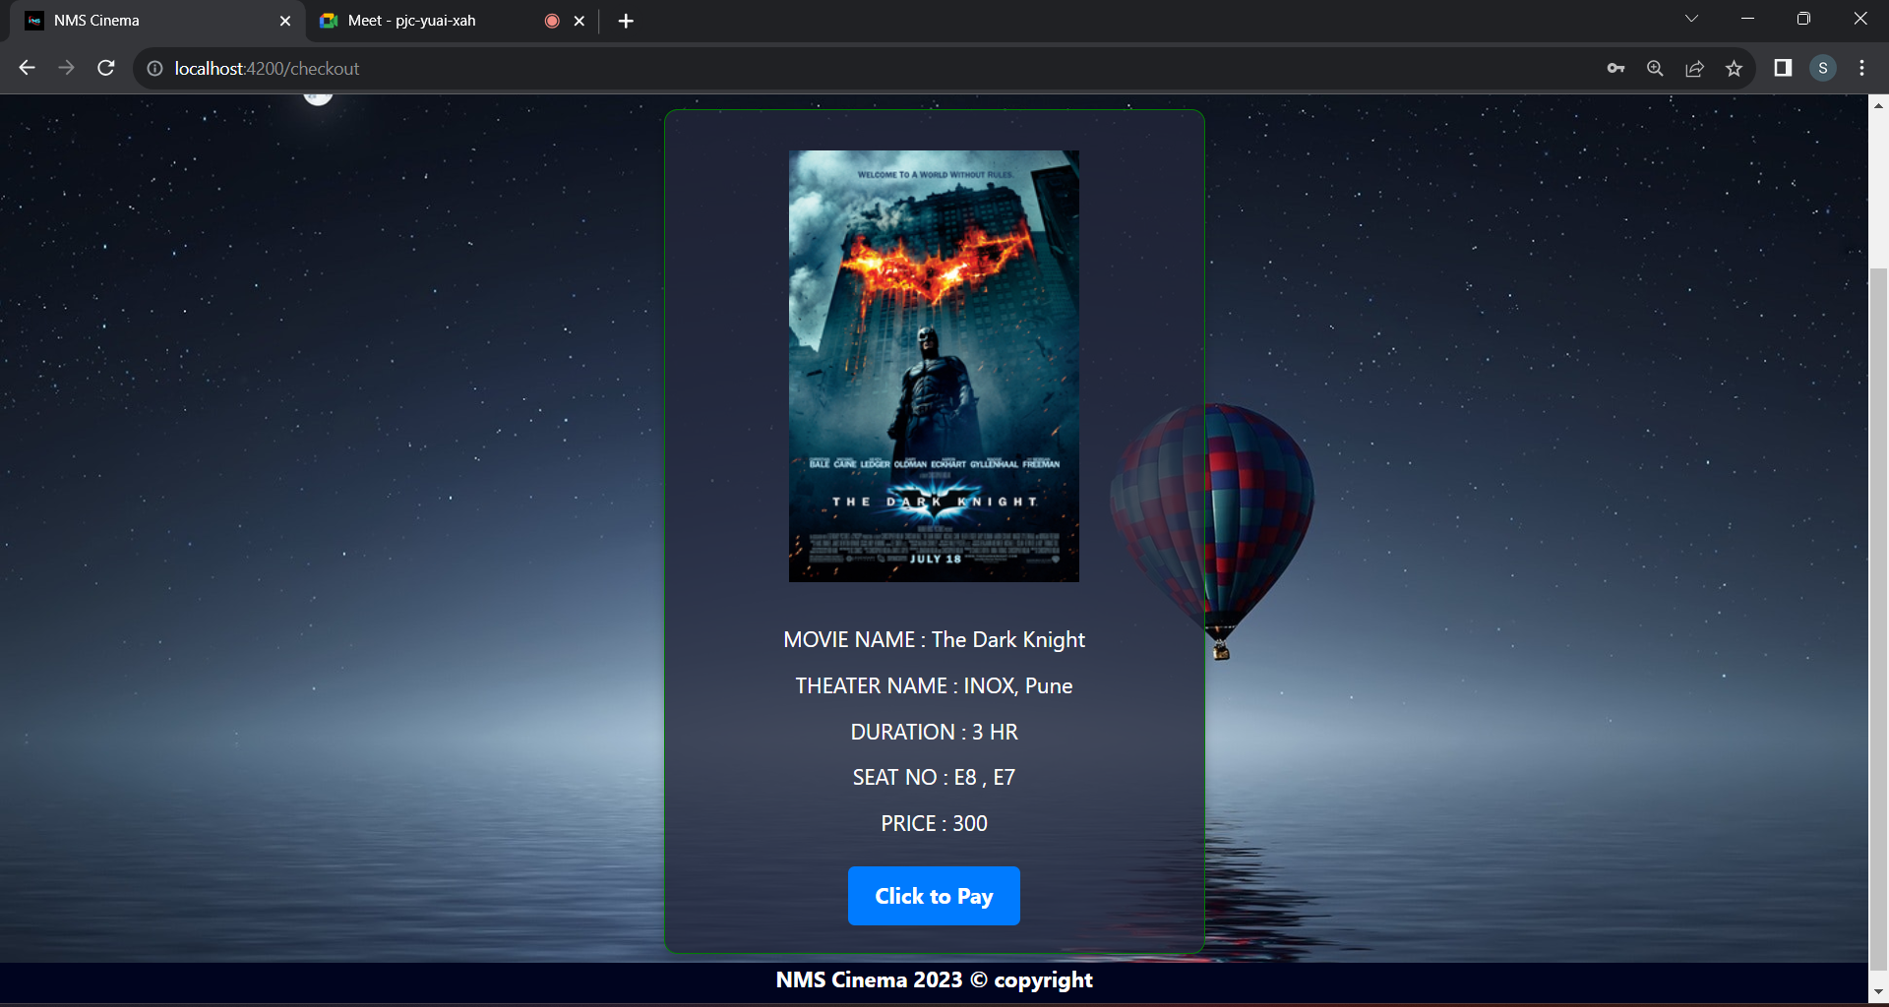
CHECKOUT

Slide 28
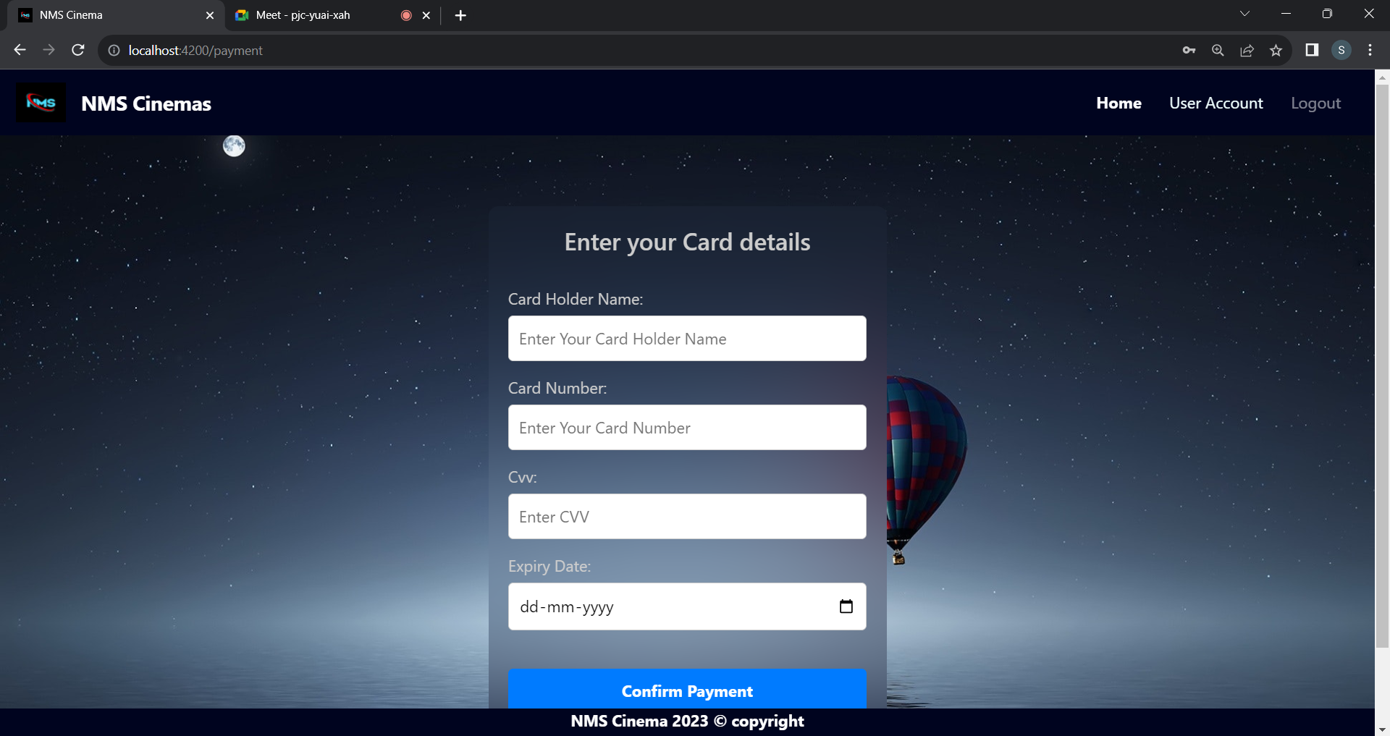
PAYMENT

Slide 29
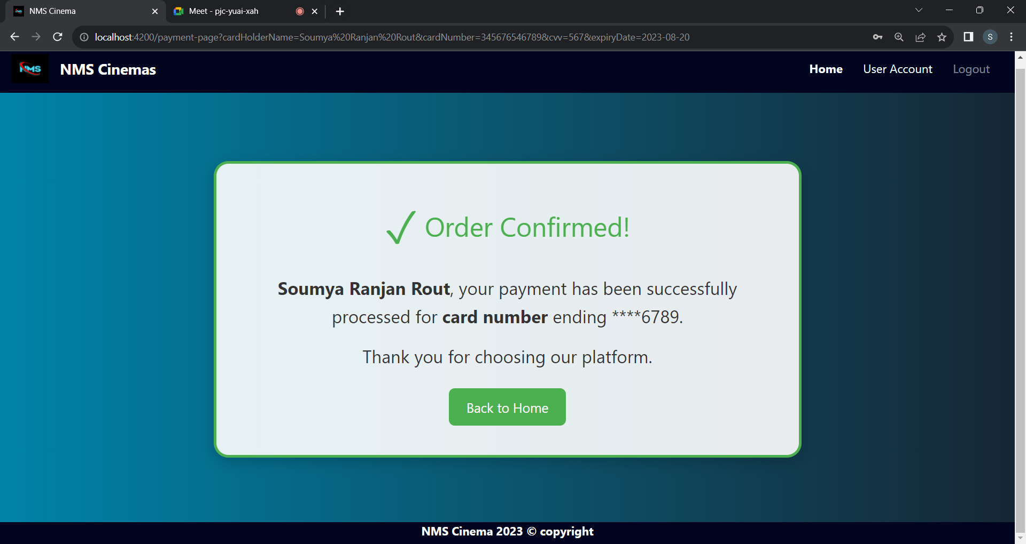
ORDER-CONFIRM

Slide 30
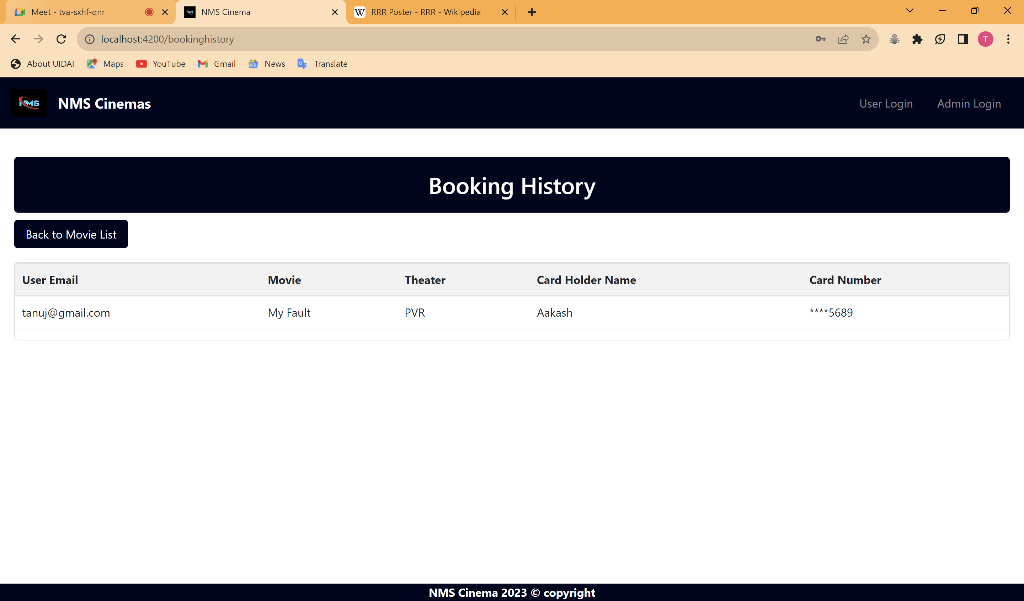
BOOKING-HISTORY

Slide 31
Conclusion:
The Online Movie Ticket Booking System, an outcome of the burgeoning Internet technology, facilitates streamlined movie ticket reservations through secure online platforms. This innovative solution not only eradicates the time-consuming ordeal of queuing but also underscores its commitment to user convenience and safety through sophisticated online interfaces. This paradigm shift in entertainment consumption encapsulates the essence of modernity and efficiency.

Slide 32

Thank you!

